Slide 1

Global Life expectancy analysis
Presented By:
Dhruv Patel, Cole Price, Clayton Tucker, Caleb Damron, Danyil Chuprynov
Notes:
All

Slide 2

Objective
Main Research Question:
What social, economic, and environmental factors were most associated with life expectancy across countries before the COVID-19 pandemic?
Key Goal:
Build a unified dataset and identify global patterns, correlations, and outliers.
Notes:
Caleb

Slide 3
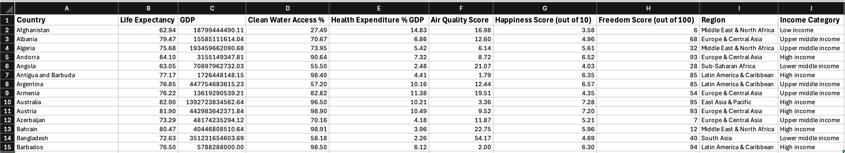
Data Overview
Sources Used (all pre-2020):
World Bank, WHO, UNICEF, World Population Review, Wikipedia, Kaggle.
Master Dataset:
193 countries, 9 factors (life expectancy, GDP, clean water access, health spending, happiness score, air quality, freedom, region, and income category)
Notes:
Caleb

Slide 4
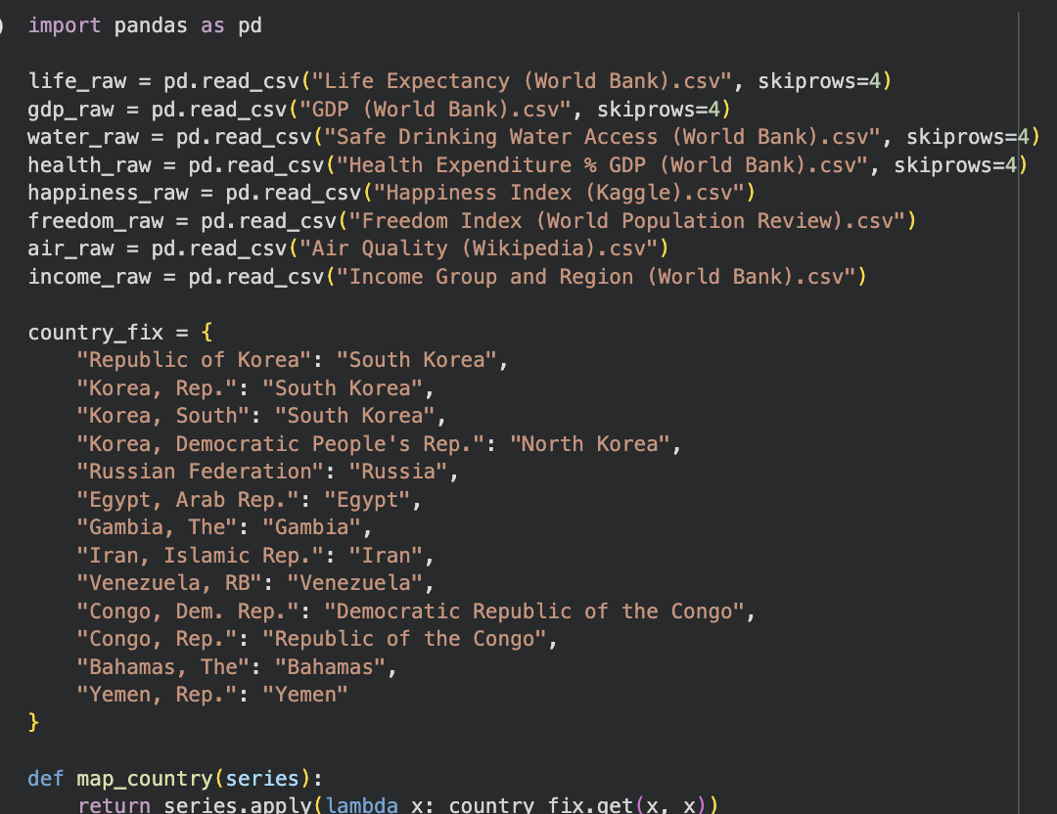
Data Cleaning & Integration
8 datasets merged
Standardized country names (e.g., “Republic of Korea” → “South Korea”)
Filled missing values using alternative reputable sources
Unified into a single master table
Notes:
Dhruv

Slide 5
Methods
We used:
  Descriptive statistics
  Pearson correlations
  Grouping by region & income
  Outlier detection
Goal: reveal broad global patterns, not build predictions.
Data
Cleaning
Analysis
Visualizations
Notes:
Dhruv

Slide 6
Key Results: Global Trends
Average life expectancy across all countries: 72.4 years
High-income ≈ 79.6
Upper-middle ≈ 73.3
Lower-middle ≈ 67.0
Low-income ≈ 61.8
Notes:
Danyil

Slide 7
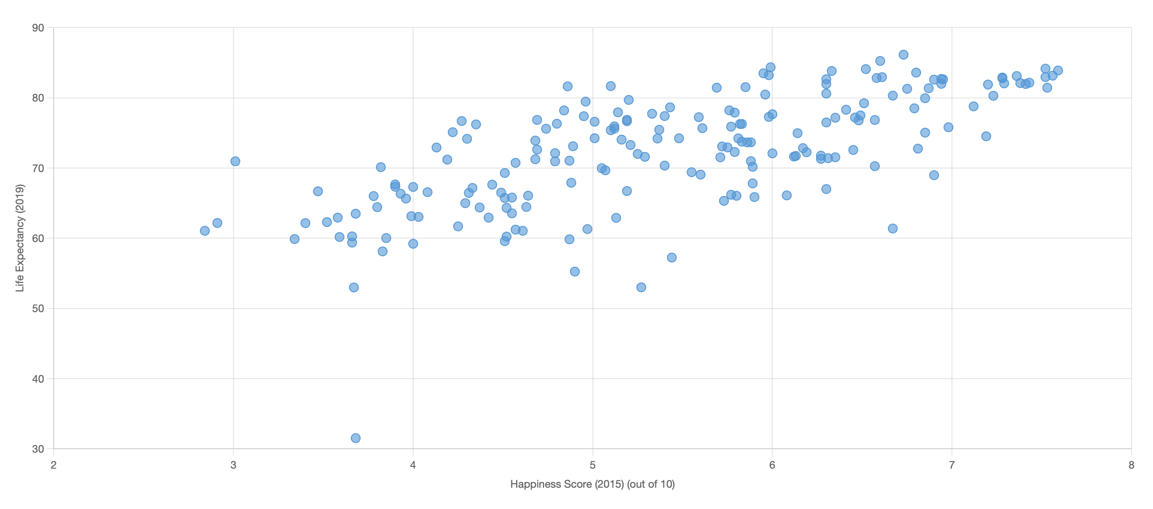
Correlations
Highest correlations with life expectancy:
  +0.69 Clean water access
  +0.69 Happiness
  +0.48 Freedom
Weaker correlations:
  +0.20 Health expenditure
  +0.18 GDP
Negative correlation:
  –0.20 Air pollution (Lower = better)
Notes:
Danyil

Slide 8
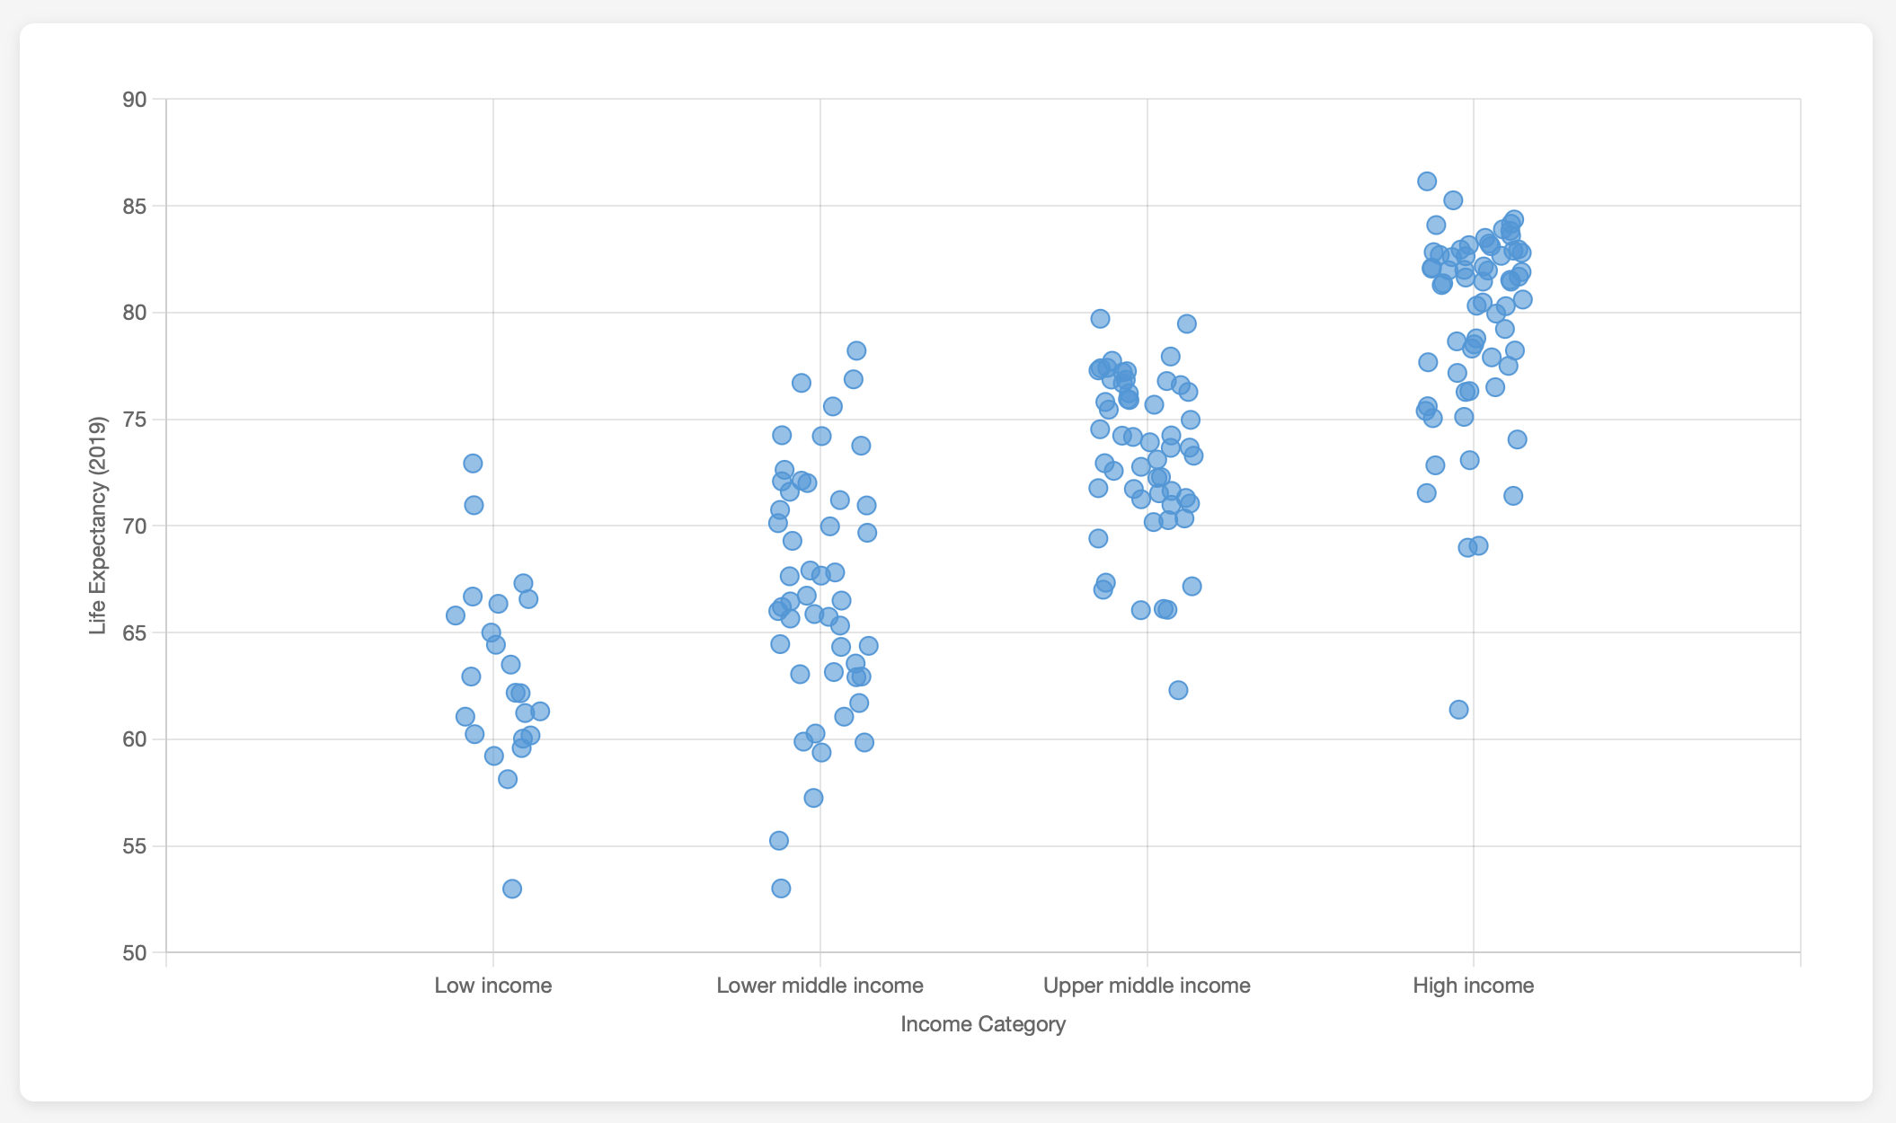
Outliers
High-performing low income:
  Syria, North Korea
High-performing lower-middle income:
  Jordan, Lebanon, Sri Lanka, Tunisia
Low-performing upper-middle income:
  Fiji, Marshall Islands, South Africa, Tuluva, Botswana, Guinea, Gabon
Low-performing high-income:
  Nauru, Guyana, Bahamas, Trinidad & Tobago, Russia, Seychelles
Notes:
Clayton

Slide 9
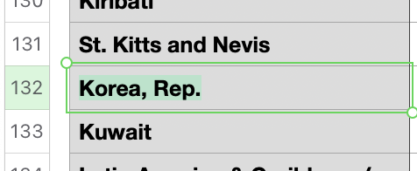
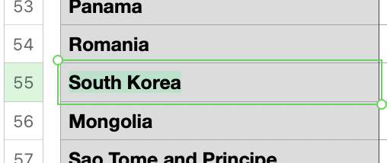
Issues Encountered
Inconsistent naming conventions
Missing factors across datasets
Different years (2015–2019)
Manual validation / missing data filling required
Notes:
Clayton

Slide 10
Future Work
Add GDP per capita + inequality metrics
01
Use time-series & post-COVID data
02
Add environmental + health indicators (PM2.5, smoking, chronic disease)
03
Build predictive models
04
Expand the interactive dashboard
05
Notes:
Cole

Slide 11
Thank you!
Questions?
Presented By:
Dhruv Patel, Cole Price, Clayton Tucker, Caleb Damron, Danyil Chuprynov
Notes:
All

